Slide 1

Blocking the Blocker – Studying the effects of Anti Ad-blocking
Rohit Gupta & Rohit Panda
Technische Universität München
Fakultät für Informatik
München, 7. August 2018

Slide 2
Introduction
Online advertisements drives the economy of the World Wide Web.
Promotional content (ads) are now strategically placed on webpages to attract attention of the users.
Users are installing Ad-blocker tools citing interference with user experience, privacy and protection against malware as the top reasons.
Publishers are employing Anti Ad-blockers, scripts and notification mechanisms that ask users to disable any existing installed Ad-blocker tools.

Slide 3
Roadmap
In our paper, we study various aspects of Anti Ad-blockers including:
We study the usage of Ad-blocker scripts and their mechanisms.
We collect and analyse data from top websites using Alexa Web Ranking.
We discuss the methodology used in detecting Anti Ad-blockers and present our results.
We discuss the economic impact of Anti Ad-blockers and how GDPR affects Anti Ad-blockers.
We discuss the legality and ethical aspects of using Anti Ad-blockers.
We discuss alternatives to Anti Ad-blocking.

Slide 4
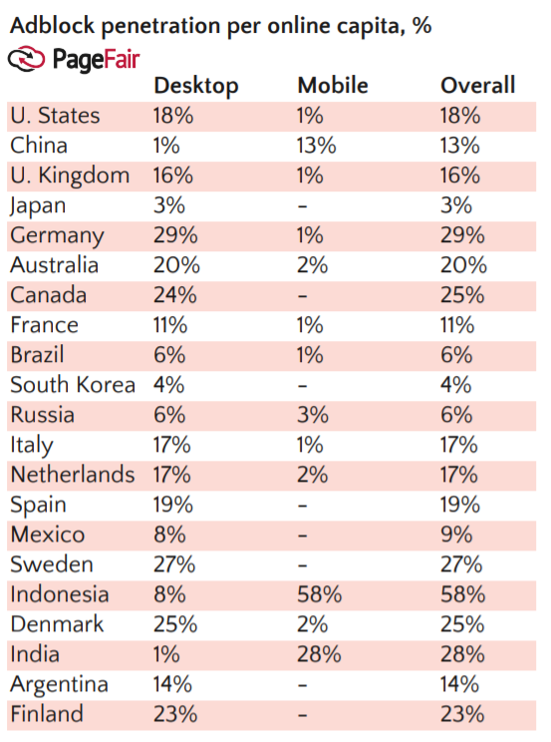
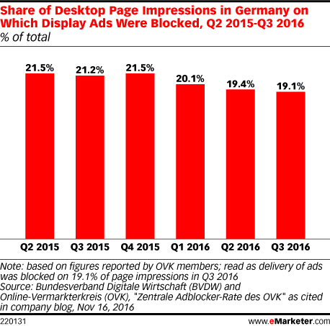
Ad-blocker popularity in Germany
PageFair Adblock penetration vs BVDW* and OVK⁺ page impressions.
Source: PageFair and www.eMarketer.com
BVDW* - Bundesverband Digitale Wirtschaft
OVK⁺ - Online -Vermarkterkreis
Notes:
The total number of devices using Ad-block > 615 million devices by 2016.
Urban users were 17% more likely to install Ad-blockers than those in rural areas.
Global cost of ad blocking surpassed the projected numbers of $40B in 2016
PageFair -> # of installations
BVDW and OVK -> Actual number of websites

Slide 5
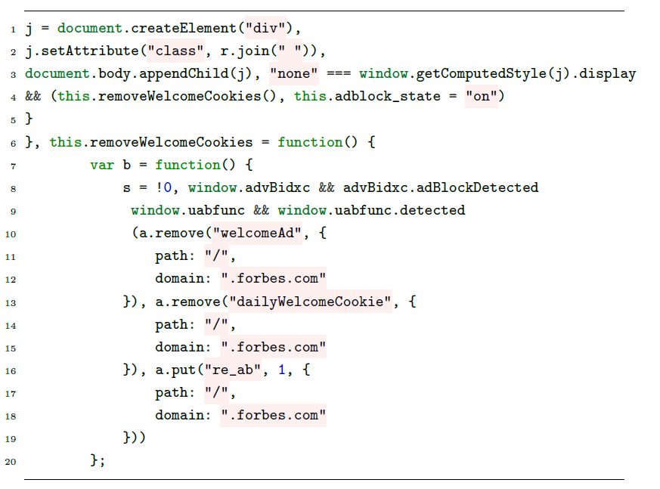
How Ad-blockers work
Code showing how Forbes implements ads on their website:

Slide 6
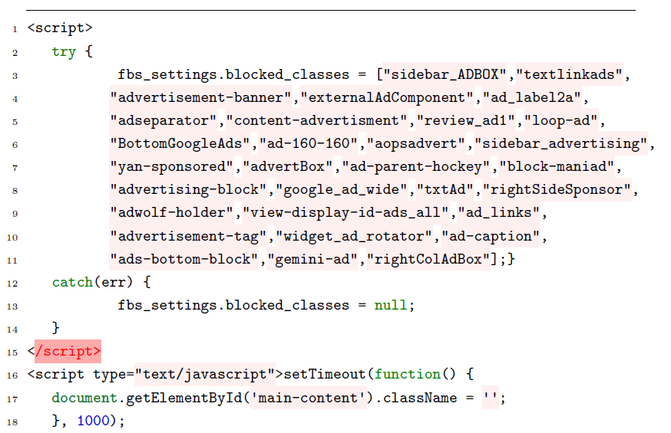
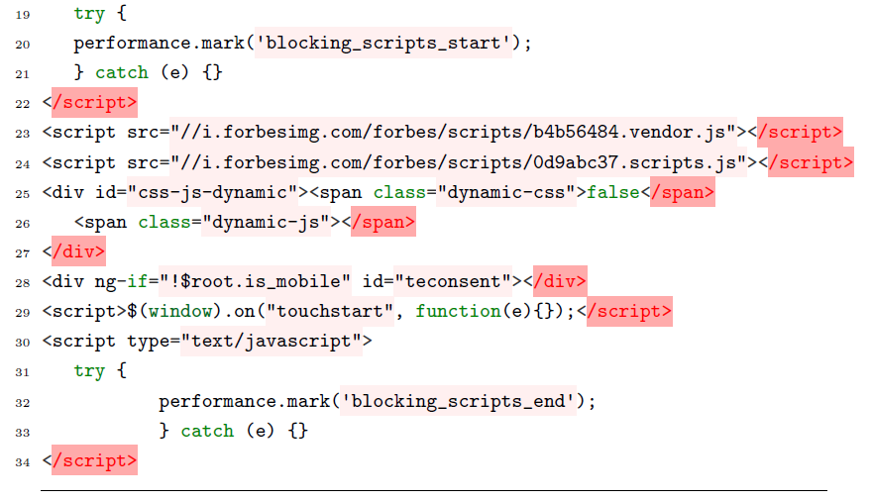
How Ad-blockers work
Code showing how Forbes implements ad-blocker detection on their website:

Slide 7




Ad-blocker extensions
μBlock Origin for Chrome and Firefox
AdBlock for Chrome
Adblock Plus for Firefox, Chrome, Opera and Safari
AdBlock Pro for Chrome
Adguard for Chrome and Firefox
AdRemover for Chrome
Ghostery for Chrome, Firefox, Opera, Safari, Internet Explorer, Android and iPhone iOS
Simply Block Ads! for Chrome
SuperBlock AdBlocker for Chrome
μ Adblock for Firefox
uMatrix for Firefox, Chrome and Opera

Slide 8
Data Collection
We collected top websites from Amazon Alexa Website Rankings
Publicly only top 50 websites for each category is available, we subscribed to a 7-day free trial to collect the following data sets:
Top 500 websites in Germany
Top 500 websites each in Germany, Austria and Switzerland (DACH region) and created a unique subset of these websites.
Top 500 websites in the category: News
Sample HTTP request to pull data from AWIS:
https://awis.amazonaws.com/api?Action=CategoryListings&Count=20
&Descriptions=True&Path=Top%2FNews
&Recursive=False&ResponseGroup=Listings
&SortBy=Popularity&Start=1
Notes:
We used paging mechanism to create multiple requests as AWIS allows only 20 per request
Access Key obtained from Amazon AWS Student Pack

Slide 9
Detecting Anti Ad-blockers: Motivation
Our papers of reference are:
Haris et al. "Detecting Anti Ad-blockers in the wild“
Rishab et al. "Adblocking and Counter-Blocking: A Slice of the Arms Race“
Their papers used Alexa top 100K websites which bias towards a US and China specific website list.
Our focus is on Germany, DACH and a specific category News.
Notes:
We chose News because this is the category that produced most Anti Ad-blocker deployments.
We chose Germany and DACH because little to no research has been done in this region.

Slide 10
Detecting Anti Ad-blockers: Overview
Anti Ad-blocker scripts detect and change HTML or DOM contents by:
adding extra HTML elements,
change in style of existing HTML elements,
changes in textual context.
As described by Haris et al. in their paper. these changes could be:
Nodal Changes: Adding extra DOM elements
Style Changes: Modifying style and appearance of DOM elements
Textual Changes: Changes in textual content
Structural Changes: Such as URL redirections

Slide 11
Detecting Anti Ad-blockers: Methodology
We make use of Selenium Chrome Webdriver to launch two separate instances of Google Chrome for A/B testing.
Instance A is launched with Adblock Plus extension and instance B is without any extension.
Instances are compared w.r.t Node Features (div, h1, h2, h3, img, table, p, iframe and text nodes), Textual Features (#lines, #words, #text) and Structural Features (URL redirection).
These features are compared using a Python script and BeautifulSoup library is used for recording the difference and screen scraping.
These features are stored in a .csv file.

Slide 12
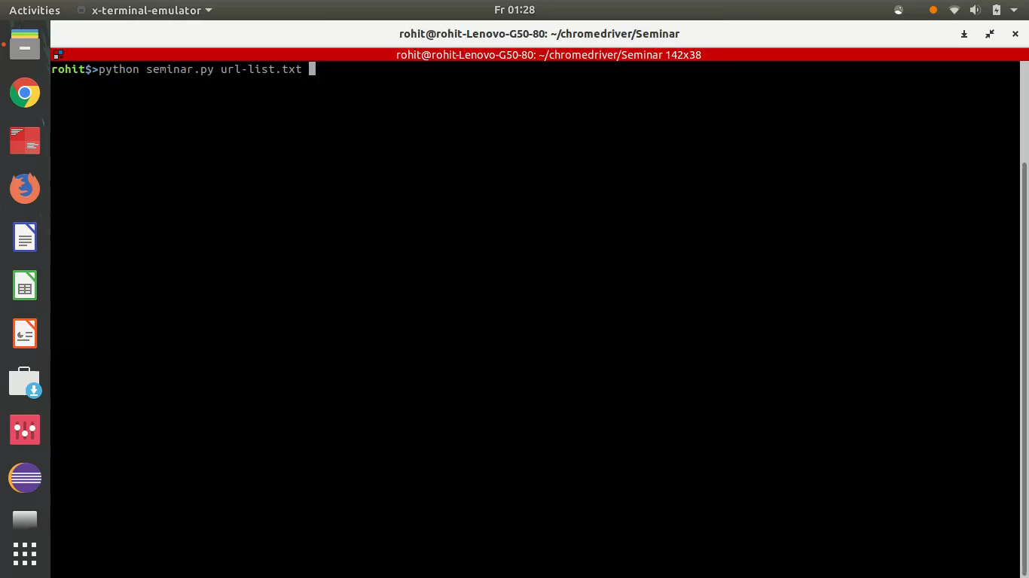
Detecting Anti Ad-blockers: Demo

Slide 13
Detecting Anti Ad-blockers: Model Training
We use three Machine Learning classifiers: J48 Decision Tree, Random Forest and Naive Bayes to identify websites that employ anti Ad-blockers.
We collected positive samples (websites that employ Anti Ad-blockers) and negative samples (websites that do not employ Anti Ad-blockers) from sources such as anti-adblock-killer list and Alexa top-100 websites.
Information gain ratio is used for determining which features extracted are most important for learning and prediction.
Notes:
We then feed the extracted features to machine learning classifiers such as…
We use WEKA data mining toolkit for these classifiers.

Slide 14
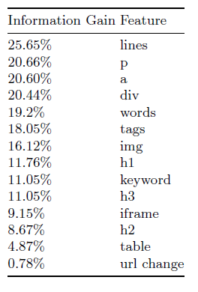
Detecting Anti Ad-blockers: Feature Analysis
Following are the features ranked based on the Information Gain:

Slide 15
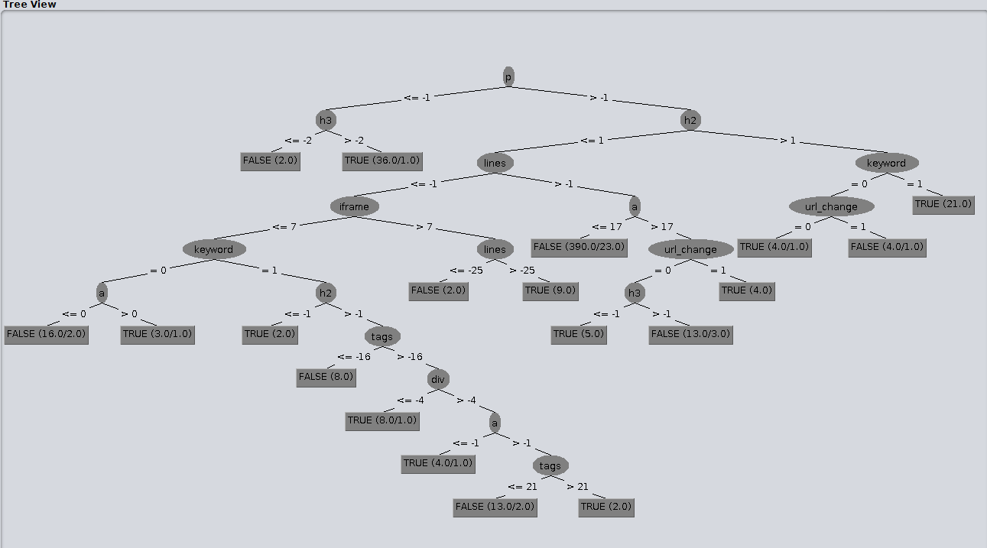
Detecting Anti Ad-blockers: Classifier Evaluation
Decision Tree visualization for Anti Ad-blockers (using Weka toolkit):
Notes:
The splitting criterion is the normalized information gain (difference in entropy). The attribute with the highest
normalized information gain is chosen to make the decision.

Slide 16
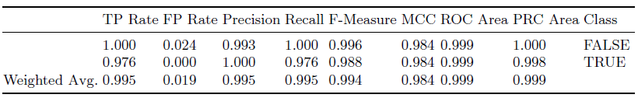
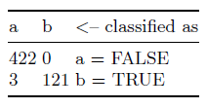
Detecting Anti Ad-blockers: Classifier Evaluation
Detailed Accuracy by Class for Random Forest classifier:
Confusion Matrix for Random Forest classifier :
Also done for Bayes Naive and J48 Decision Tree using Weka toolkit.

Slide 17
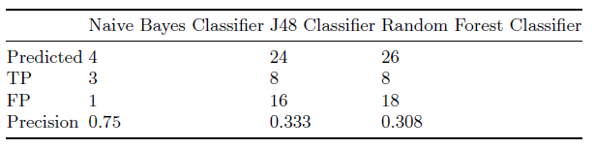
Datasets and Results: Germany
From the list of top 500 websites in Germany using Alexa Website Rankings, we were able to successfully create a test set of 418 websites:
8 out of the 418 websites (1.9%) top visited German websites employ Ad-block detection.

Slide 18
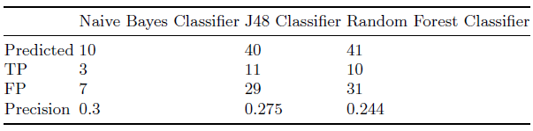
Datasets and Results: DACH region
From the list of top 1500 websites in Germany, Austria and Switzerland using Alexa Website Rankings, we were able to successfully create a test set of 809 unique websites:
11 out of the 809 websites (1.4%) top visited German websites employ Ad-block detection.
The low precision is attributed to a lot of websites deploying data protection (GDPR) information on the main page or are allowed under Acceptable Ads programme.

Slide 19
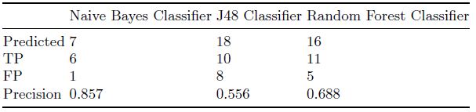
Datasets and Results: News category
From the list of top 500 websites in the News Category using Alexa Website Rankings, we were able to successfully create a test set of 357 websites:
11 out of the 357 websites (3.1%) top visited news websites employ Ad-block detection.
The high precision for News websites is synonymous with the results presented by our reference papers by Haris et al. and Rishab et al.

Slide 20
Ad-block Detection Responses: “CIA” measure
We verified the positive samples for Ad-block detector responses.
We define a new measure called the “CIA” measure for such responses:
Cost Model (C): We describe this type as a cost or monetization model.
Invisibility (I): We describe this type as not allowing users to view content until Ad-blockers are disabled.
Availability (A): We describe this type as a conservative approach, allowing users to view content but asking them politely to disable Ad-blockers.

Slide 21
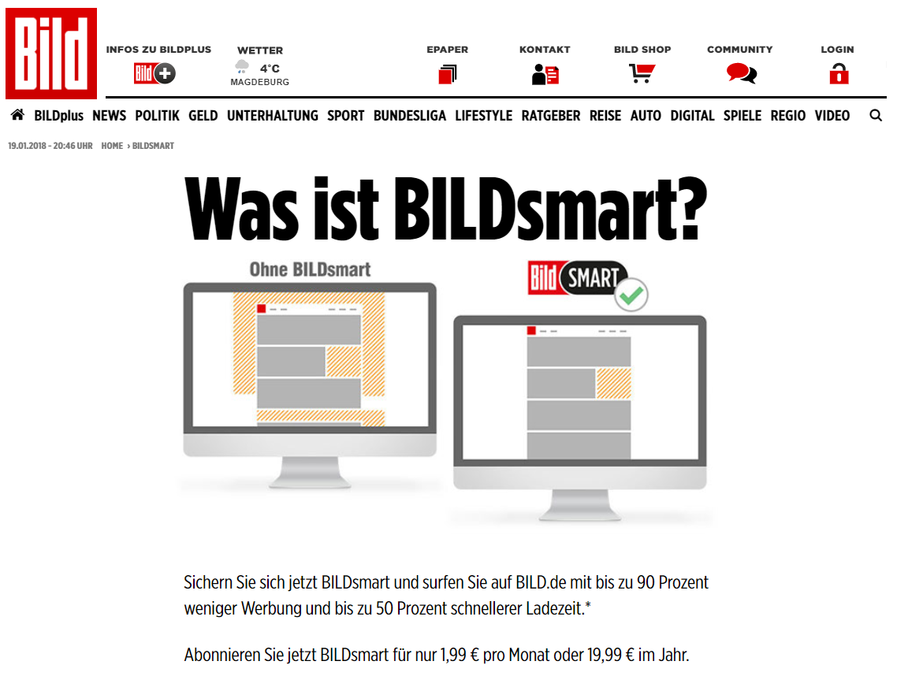

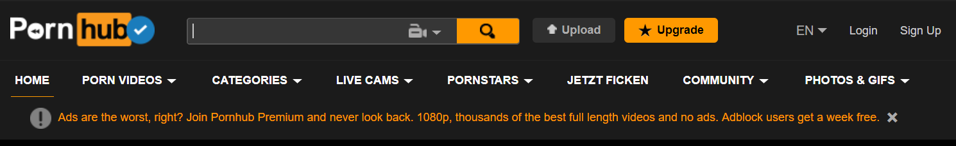
Ad-block Detection Responses: ‘C’IA example
Source: www.bild.de, www.washingtonpost.com and www.pornhub.com

Slide 22
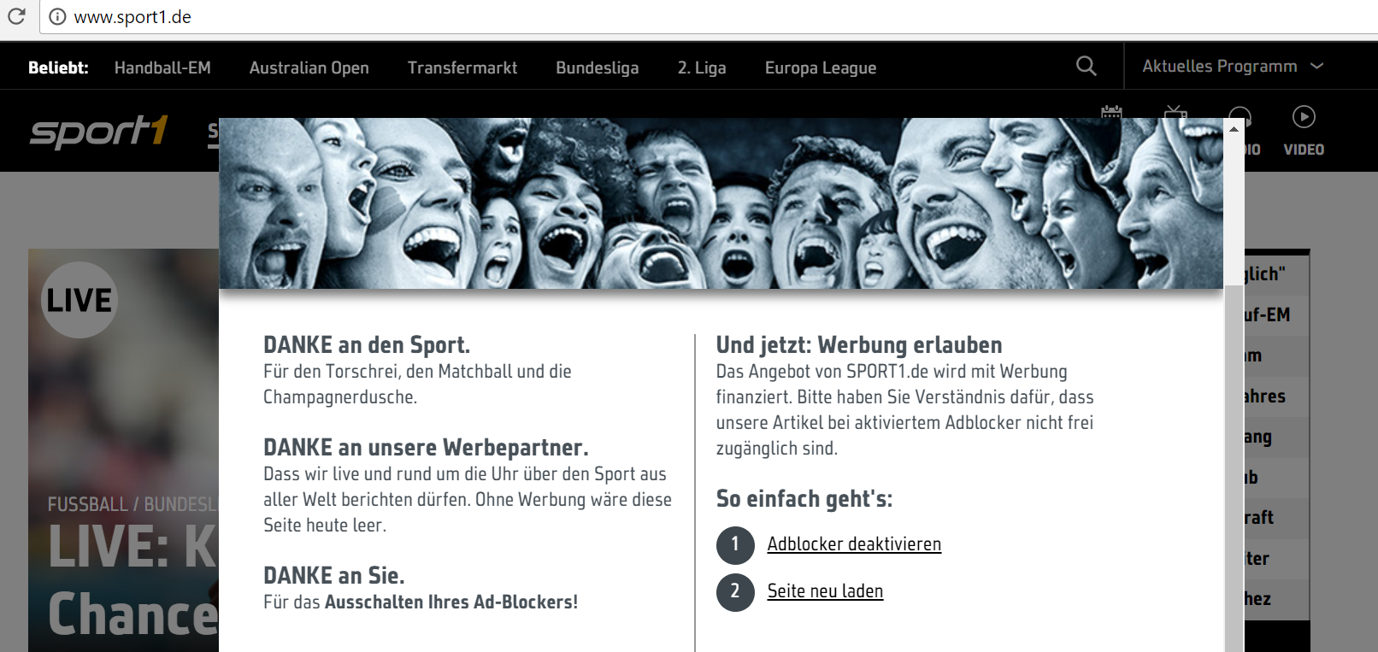
Ad-block Detection Responses: C’I’A example
Source: www.sport1.de

Slide 23
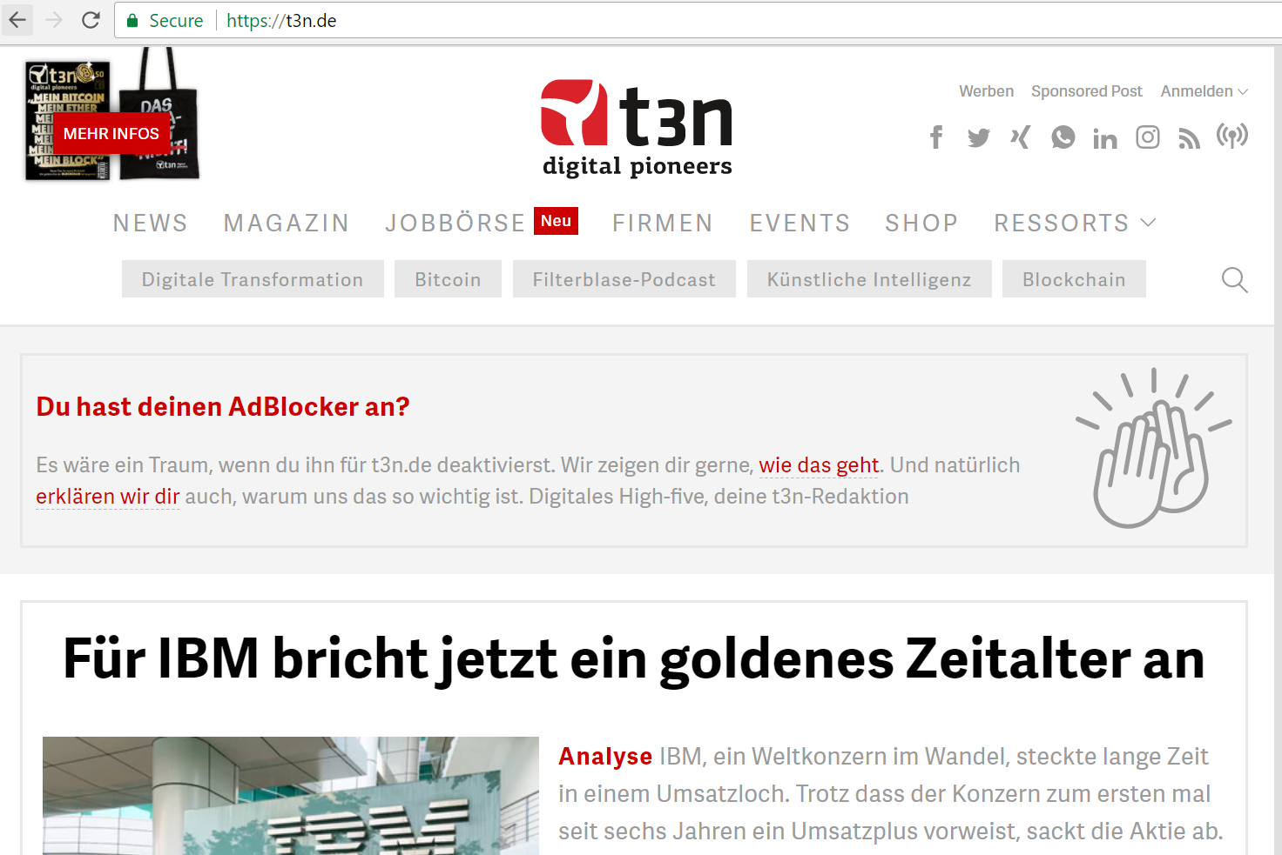
Ad-block Detection Responses: CI’A’ example
Source: www.t3n.de

Slide 24
Datasets and Results: Geographical Comparison
Our reference paper by Haris et al. focussed on Alexa top-100K websites that includes majority of U.S.A. and China websites.
They found 686 websites in Alexa top-100K (6.7%) deploy Ad-blocker detection.
In our analysis we found that 1.9% websites (out of 418 German websites) and 1.4% (out of 809 websites in DACH region) employ some kind of Ad-blocker detection.
Notes:
Only google.de and amazon.de fall under the Alexa top-100 websites.

Slide 25
Limitations
We remove all anti Ad-block filters in the Adblock Plus’ filter list. This may not be the default configuration.
Our methodology focusses only on homepage of such websites.
We consider only HTML, DOM and textual changes to websites.
Our focus is on Adblock Plus due to its popularity.
We do not consider style features and cosine similarity used by our reference papers.

Slide 26
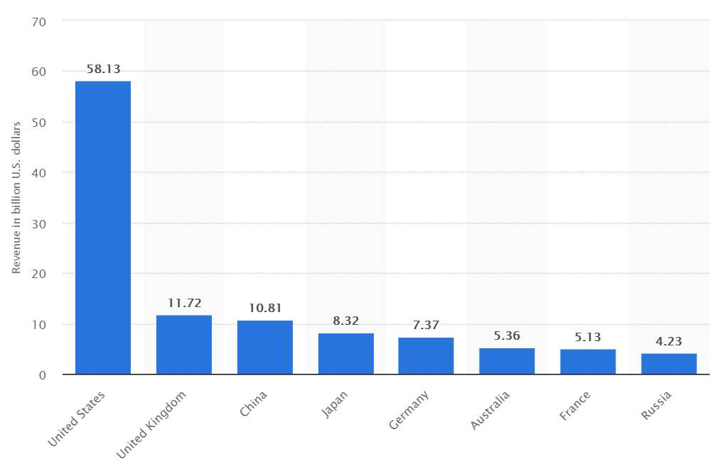
Economical Impact
U.S. leads the market share with $58.13b revenue in 2017 followed by the U.K. with $11.72b and China with $10.81b.
Source: www.statista.com
Notes:
The major revenue categories ranked by percentage shares are as follows:
Search Advertising with $3.44B - 48%
Banner Advertising with $1.46B - 20.5%
Classifed Advertising with $0.95B - 13%
Social Media advertising with $0.89B - 12.5%
Video Advertising with $0.40B - 6%

Slide 27
Anti Ad-blockers: Legality in Germany
There have been many legal battles fought till date, e.g., between Adblock Plus company Eyeo and Sueddeutsche Zeitung, Pro-Sieben-Sat.1, and IP Deutschland. However, German courts have always ruled in favour of Ad-blockers.
The Munich higher regional court did not classify Eyeo's business model as “forbidden aggressive advertising”.
It is legal!
Notes:
- Cases against Eyeo because companies say that Eyeo is monetizing to let them join these whitelists under the Acceptable Ads programme
- After all who knows, maybe the judges also use ad-blockers.

Slide 28
Anti Ad-blockers: Ethical aspect
Ads are the biggest sources of revenue for publishers on the world wide web.
Many websites have come up with a subscription model.
Some publishers, part of the Acceptable Ads programme, may not reveal all details regarding their deal with Ad-blocker companies.
Here is where the “CIA” measure can be used to classify if the business model is ethical or not.
Notes:
Pay journalists for their work on reporting.
While users should pay for viewing original content, ads should not be so intrusive.
On the other hand, if users choose to block ads, websites should not force them to disable ad-blockers.
- Charges a small fee to display content with less advertisements.

Slide 29
Anti Ad-blockers: Impact of GDPR
The General Data Protection Regulation (GDPR) does not allow companies to store or use user's personal data unless explicitly agreed by the user.
However, detecting Ad-blockers work mostly on the concept of identifying HTML and DOM elements which are completely unrelated to the users (still complying with GDPR).
Websites that do not fully understand the risks of data protection are only providing full text content or country redirection links to an ad-free EU version of their websites.

Slide 30
Anti Ad-blocker Alternatives: Acceptable Ads
Acceptable ads programme is provided by Adblock Plus for providing ads that do not disrupt or distort web content for users. The following criteria must be followed for an ad to be an Acceptable Ad:
Placement
Distinction
Size
Unacceptable ads include animated ads, autoplay, expanding ads, pop-ups and pop-unders, rich media ads.
Notes:
Placement: Ads must not disrupt the user’s natural reading flow. They must be placed on the top, side or below the Primary Content.
Distinction: Ads should not be mixed with any other content so that it overlaps with the Primary Content.
Size: A strict individual size requirement is placed for Acceptable Ads.
Google Adsense

Slide 31
Anti Ad-blocker Alternatives: Whitelists
This is analogous to anti-viruses that allow certain softwares to run on the system.
Adblock Plus charges high generating revenue sources for adding their websites to their whitelists while they do not charge for low income revenue sources.

Slide 32
YES! Anti Ad-blocker killers also exists!
Anti Ad-block killers tricks sites that use Anti Ad-blocker detection into thinking the user is not using an Ad-blocker.
Anti Ad-block killers such as AAK are composed of a user script AakScript written in JavaScript with a default filter list similar to that of AdBlock and AdBlock Plus.
Ad-blockers still continue to run as normal using script managers like Greasemonkey or Tampermonkey.

Slide 33
Conclusion
1.4 – 1.9% websites use Ad-block detection scripts for a specific country or region, whereas 3.1% websites use these scripts for a specific category such as News.
For us, Bayes Naive classifier generates the highest precision in contrast to our reference paper by Haris et al.
German courts have ruled in favour of Ad-blocker extensions till date and GDPR as such does not directly affect the working of such scripts.
Notes:
While websites ads to generate revenues, users consider them to be annoying or potentially dangerous to their
system. However, such websites, question the integrity of such an unsaid agreement between
users and publishers by asking users to disable Ad-blockers. As such, the cat and mouse continues…

Slide 34
References
Haris et. al. Detecting Anti Ad-blockers in the wild. Proceedings on privacy enhancing technologies (2015)
Rishab et. al. Ad-blocking and counter blocking: A slice of the arms race (2016)
Garimella et al. Ad-blocking: A study on performance, privacy and counter-measures (2017)
Amazon Alexa Website Rankings: https://www.alexa.com/topsites
Digital advertising in Europe - Statistics and Facts (2017) https://www.statista.com/topics/3983/digital-advertising-in-europe/

Slide 35
Thank you!

